Slide 1
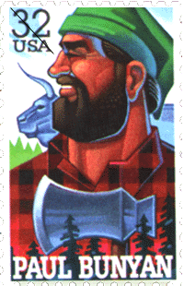
What is a Tall Tale?

Slide 2
Tall tales were first told in America by the settlers who made their homes in the American wilderness. In those days, people didn't have TV, computers or electricity to read by, so they told stories for their entertainment.

Slide 3
Famous Tall Tale Characters
Some famous tall tale heroes are
Johnny Appleseed,
Pecos Bill,
Paul Bunyan,
Davy Crockett,
Sally Ann Thunder Ann Whirlwind Crockett, Mike Fink,
John Henry, and
Annie Oakley

Slide 4
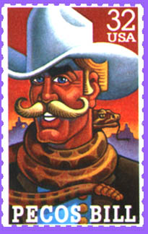
Elements of Tall Tales
First, The main character does things that seem impossible for people, or has super-human abilities, this makes them bigger than life.

Slide 5
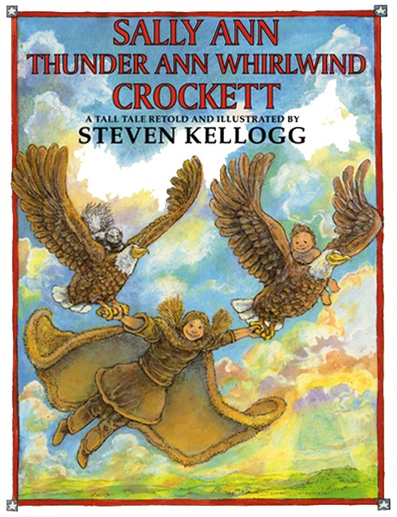
Second, the story has many exaggerations in it. Looking at this cover can you name a few?

Slide 6
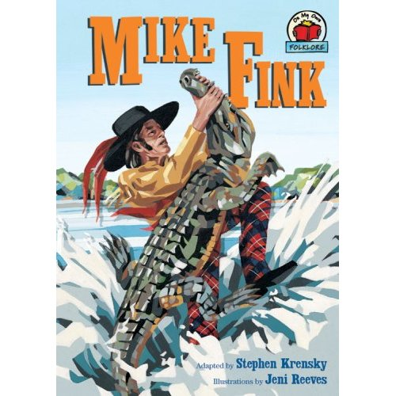
Third, the main character has a problem or problems to solve.

Slide 7
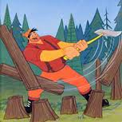
Fourth, the story includes lots of action.

Slide 8
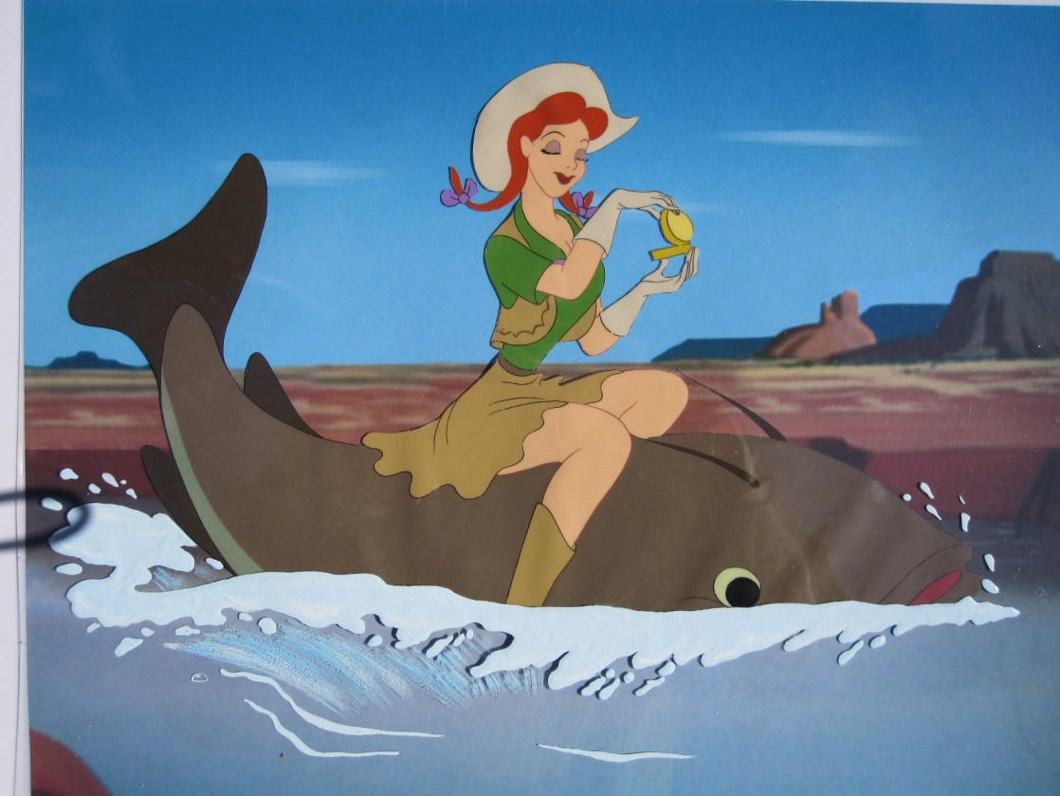
Fifth, The plot of the story is funny and impossible.

Slide 9
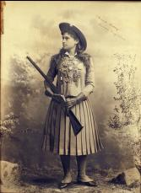
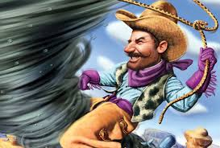
Lastly, the main character solves a problem, overcomes an obstacle and/or defeats the “bad guy”.

